Slide 1

LOAN DATA ANALYSIS – DATA ANALYSIS PROJECT

Slide 2
Loan Data Analysis
Let me Explain how data analyst works in a real-world industry by taking example of Loan Data Analysis Project.
Steps Followed in Data analysis Process
Problem statement
Data Collection
Data Cleaning
EDA process
Creating Dashboard
Conclusion

Slide 3

Step 1: Problem Statement
Find the demographic characteristics of the loan applicants.
Find the credit history of loan appliacants with respect to gender and influence of credit history on loan status.
Find the sum of loan amount by gender and marital status.
Find the maximum and minimum loan amount applied.

Slide 4
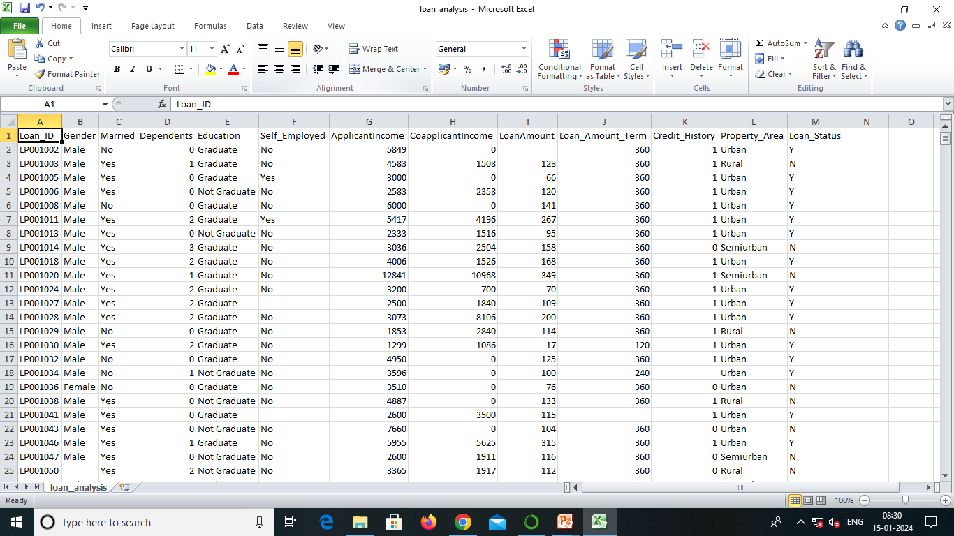
Step 2: Data Collection
Data Format: CSV
Data Size: 38 KB
Collection of measurements:
Total No. of Columns : 13
Total No. of Rows : 614
Column Names:
Numerical Data/Columns : Dependents, Applicants income, Co-applicants income, Loan amount, Loan amount term, credit history
Categorical Data/Columns : Loan id, Gender, Married, Education, self-employed, Property-area, Loan status.

Slide 5
Step 3: Data Cleaning
Data cleaning process is done by using ETL (Extract, Transform, Load) technique.
Extract: Extract the data from file in csv, sql format of file.
Transform: Transform is nothing but modify or change the data. In this step we clean all the data, to find missing values and filled them using python libraries(like pandas and numpy). So new values are added to the existed raw data and to make it clean.
Load: Load or upload the cleaned data into database or in any desired location.
Data cleaning is done by using Python in Jupyter Notebook
By using pandas library we accessed the data / read the file using following code:
df = pd.read_csv(‘loan_analysis.csv’) # RAW DATA IS IMPORTED TO CLEAN IT
Here df is a variable in which data is stored to perform operations, pd refers to pandas.

Slide 6
Using df.info() we check total numbers of columns and rows present in our dataset and datatypes of each column.
Using pd.isnull(df).sum() we check the null values present in the dataset df.
In this loan data we have total 13 columns and 613 rows in which 6 columns have numerical data and remaining 7 are categorical data.
There are lot of null values in the dataset(13 rows in gender column, 3 rows in married, 15 rows in dependents, 32 rows in self employed, 22 rows in loan amount, 14 rows in loan amount term, 50 rows in credit history column).
We used mode method to replace null values in the categorical column.
used median method to replace null values in the numerical column.
Later we saved the cleaned data as LOAN_ANALYSIS_NEW_DATA.CSV to further carry on EDA process on this cleaned data.

Slide 7
Step 4: EDA ( Exploratory Data Analysis)
Here for graphical presentation and color combination we used matplotlib and seaborn libraries.
EDA technique is used to analyze cleaned data to draw informative insights.
So here we came to know that :
Majority of the loan applicants are educated male who are married.
Applicants with credit history 0 mostly get loan status "NO"
Applicants with credit history 1 mostly get loan status "YES", but with some exceptions of "NO“
Majority of loan applicants reside in semi-urban area followed by urban and rural area.

Slide 8
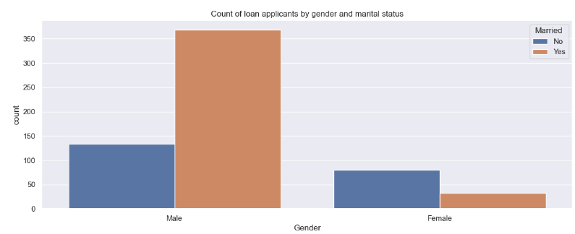
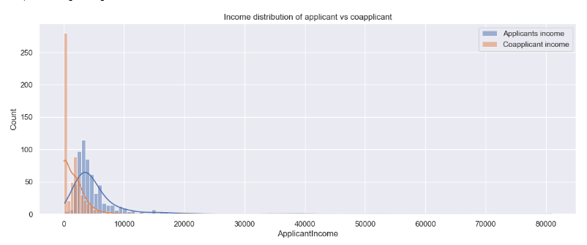
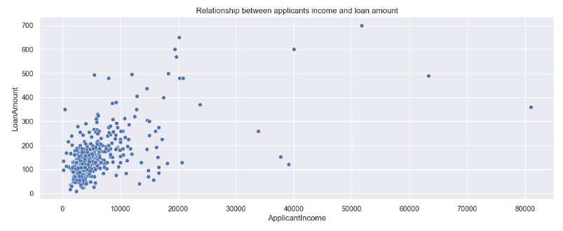
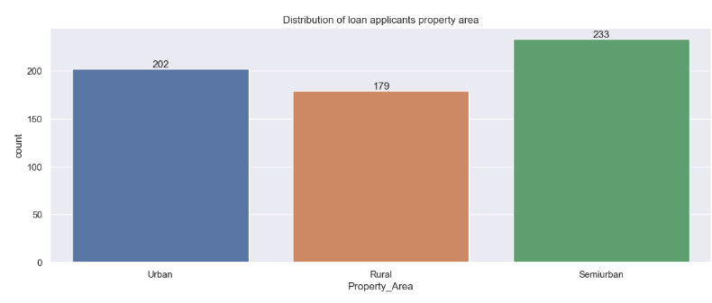
we used countplots, barplots, scatterplots, histplot to perform Exploratory data analysis and draw desired conclusions.
Here are some of the outputs;

Slide 9
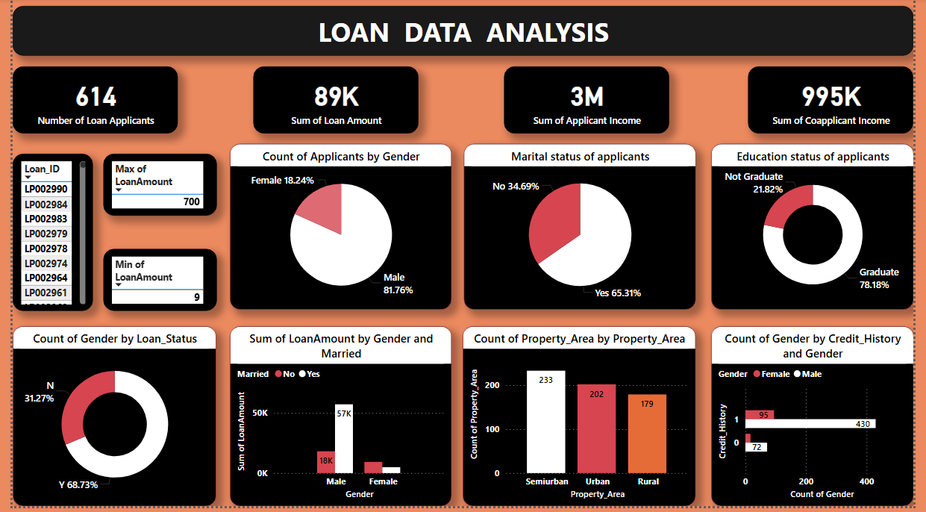
Step 4:Creating Dashboard
We have used various graphs to visualize the data;

Slide 10
Conclusion:
The majority of bank loan applicants are graduated married male who earn between 2000 and 10000 who have their loans approved and have lesser income, usually get smaller loans among which majority of them reside in semi-urban area and majority of them have credit history of "1" and have their loan status "yes“.

